Slide 1
Automation – Ed’s 2022.
12.10.2022
Ed Moore - edmoor@cisco.com
Customer Success Specialist – Automation

Slide 2
Automation – Key Points
Automation Approach – Strategic or Tactical
Automation Advocacy
Use Case Identification
Organizational Capabilities
Use Case Prioritization
Development Approach
Architectural Patterns
‘Tangible’ metrics
Use Case Catalogue
‘Agile’ Roadmap
1
2
Service Architecture
Technology Trends
As a service models
Revenue generators vs cost centers
Service Catalogue
4
3
Low Code
Controller-based Solutions*
Data driven decisions

Slide 3



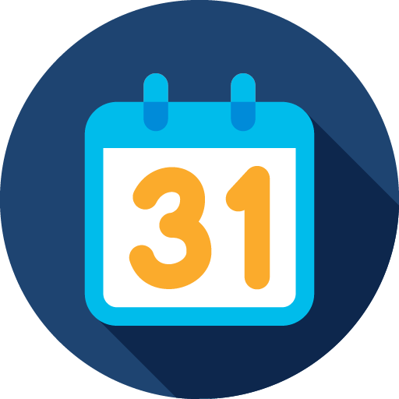



Automation Strategy
Organisations have similar themes but often unique priorities and challenges. Generally the approach is dependant on whether we’re adopting a tactical technical solution or strategic organisational transformation.
Resource Availability
Security Requirements
Time to Value
User Competency
Technical Complexity
Technical Debt
Notes:
Presenter:
Strategy is going to be largely dependant on your organisation but what we can do today are describe what some of the impacting factors are:
Resource Availability – Do you have people required to work on your programme/initiative?
User Competency – What level of competence do your users and implementers have? How does this influence the in-house vs COTS decision making?
Security Requirements – Are you restricted by the services you can provision and the tools you use to satisfy your requirements? Are there data requirements that limit how you can store configuration for example?
Technical Complexity – What is it you’re trying to achieve? Is your scope large enough that you should invest in organisational change or small enough that a few people can solve the problem?
Time to value – When do you need to see results? Your strategy could be to deliver results next week or next year depending on the other factors but is there a hard date or factor to consider?
Technical debt – How much non-standardisation and legacy artefacts are you having to drag along?
It’s important to take the above factors into consideration otherwise you run the risk of some seriously unsatisfied stakeholders – worse case is that poor planning/execution leads to corner cutting and then poor adoption by the end users. Ultimately it impacts everyone.

Slide 4
Automation Complexity
Writers' perspective
Baseline - As part of baseline phase, you should have a clear view on where you are in terms of technical sophistication and organizational composition. In large siloed organizations, it’s unlikely you’re going to develop a multi-domain orchestrator in 6 months.
A different approach such as ‘simple’ tactical implementations may be a better fit for your organization as they demonstrate their value to other groups and are more likely to succeed in siloed orgs.
Stretch goal may be to have fully automated Services – if you’ve a long way to travel it’d be prudent to build architectural patterns and a cyclical review cycle to tweak your approach towards ‘what works.’
Microservice
Management and Orchestration of multiple technology areas or operators.
Services and their interfaces should be much more defined to avoid ‘organic growth’ issues.
Pipelines
Logical execution of multiple automated steps using COTS software and business specific logic.
App-based
Utilization of common tools to solve typical issues across multiple platforms.
Scripts
Largely individually driven solutions to simple and repetitive problems.
Ad-hoc Automation
Structured Automation
Orchestration
Multi-domain Orchestration
Tactical
Strategic
Notes:
Presenter
In addition to the different subject areas there’s also a factor of complexity which is important when building your own Automation Architectures,
With most customers the Automation ‘Journey’ begin at Scripting – this is usually a Tactical solution that solves a specific purpose.
Next area App-based implementations which are typically easier to manage and expand, and supportable. Sophisticated is likely a better word than complex when compared to Scripts as they can be structured in a way that allows for lots of diverse use cases
Once you’ve delivered an automated use case or perhaps several, it becomes advantageous to chain these actions together into pipelines or workflows, this is typically done by an Orchestrator and is referred to as Orchestration. The level of sophistication at this layer varies greatly but tends to require some initial investment for benefit of improved supportability and reliability.
There is arguably a chasm between stages 3/4 which requires additional expertise and planning – Multi-domain Orchestration focuses on integrating workflows between different endpoints to provide significant business value. In most cases this would include developing architecture patterns and interface specifications to ensure your solution doesn’t end up like a ‘rabbits warren’ of ad-hoc interactions.
Generally you can view automated activities as tactical as they solve a specific technical purpose and Orchestration solutions as Strategic as they require organisational change and focus on business value.

Slide 5




Use Case Identification
Incremental Development
‘what is the business function you need to perform?
Build functionality incrementally to discover issues and opportunities for improvement as you go.
Baseline
Sanitization
Assess where you are and define the scope.
Focus on valuable assets , remove the unnecessary and focus on what benefits from the transformation.
Strategy Phases
Diverse infrastructure requires more time and investment to automate.
Each phase should aim to remove the clutter and focus on what needs to be included.

Slide 6



Automation Advocacy
People
Business Value
Metrics
Who are we solving problems for?
How do they want to consume my solution?
Self
Team
Leader
Organisation
Time saved, tickets resolved, service availability etc..
”What gets measured gets managed” - We have some internal tools that have saved millions of hours of time.

